Slide 1

GDC | 2016
Building Paragon in UE4
Developing “Paragon” - the MOBA from Epic Games.
How we optimized CPU and GPU
to run at 60Hz on PlayStation4 and PC
Notes:
"Paragon” - the MOBA from Epic Games - is approaching Early Access.
Here we share our choices and what problems we had to tackle to run the AAA game in a frame rate budget of 60Hz on PlayStation4 and PC.
We made many improvements to Unreal Engine that helped CPU and GPU performance.
The target audience is technical game developers who want to learn from our experience.

Slide 2


VIDEO
CPU
Animation
Significance
Character
Clothing
Scene Graph, Actor Ticking
Particles
Rendering
GPU
SSAO, Decals
LOD, Shadowing, SSSSS
Separate Translucency
Bloom, Eye Adaptation
Tone mapper
Depth Of Field
UI
Q&A
Benn Gallagher
Martin Mittring

Slide 3

VIDEO

Slide 4


Slide 5
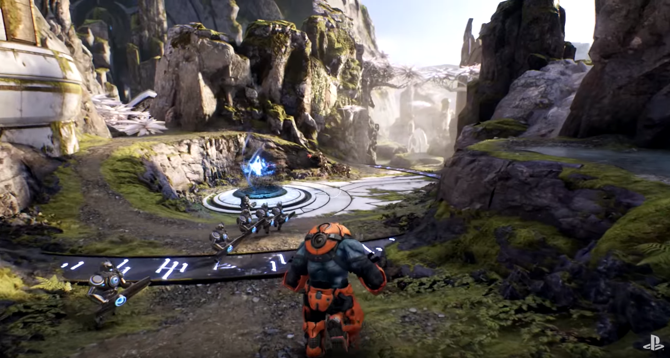
Paragon in UE4
PlayStation 4
60Hz
1600x900 for 3D, 1080p for UI
PC: Direct3D 11
Scalability
Static sun position, mostly static geometry
Baked GI (Lightmass)
Per object shadows
On screen: <=10 heroes, <=120 minion
CPU and GPU performance work needed
Complete Early Z Pass
We experimented with alternatives
Needed for DBuffer decals
Helps BasePass and occlusion
Material with PixelDepthOffset are now rendered after Opaque
Utilized position only index buffer
Notes:
PlayStation 4
CPU 2 Quad cores 1.6GHz
GPU (APU) 800Mhz 1.843TFlop/s 26.6 GPixel/s fill 57.6 GTexel/s
Memory: 8GB, 178GB/s, usable:
HD 0.5..1GB .. MB/s
Profile on PC with AMD …. 1080 Is about same perf as 900p on PS4
The hard maximum for minions is 300

Slide 6
C P U

Slide 7
Animation 1/2
Improved the three main stages of animation processing:
Tick (Game Thread)
Initially blueprints, moved to native C++
Update (Generate Blend Weights)
Moved to worker thread
Added “Fast Path” processing for variables
Evaluate (Decompress and Blend Anims)
Evaluate on a worker thread, added cooked additives, ~3x faster
Notes:
Fast Path – Removed VM calls for variable access nodes. We instead build copy records for each direct variable getter node, ends up being a memcpy. Added a specialisation for Boolean negation.
Still doing the work for update, just freeing up game thread.
General improvements across the board, not doing same amount of work as 4.10 (component blending, allocation etc.)

Slide 8
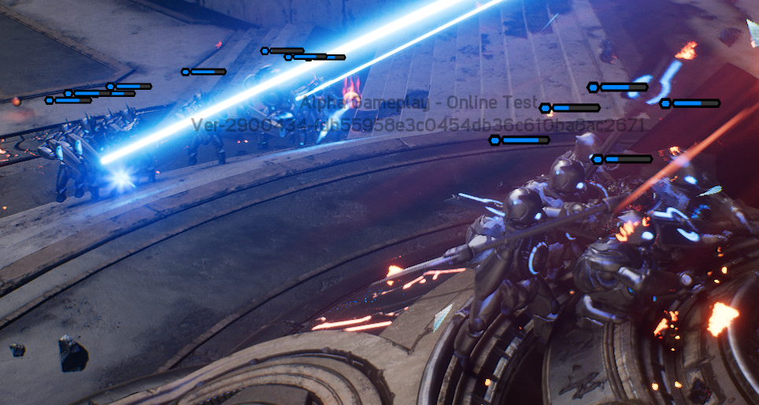
Animation 2/2
Removed large amounts of repeated allocations and added a stack allocator. ~2x faster
Fixed bounds for common meshes (Minions)
Utilized existing URO (Update Rate Optimizations)
Distant or less important meshes updated at lower rates
Skip interpolation for distant meshes
URO update buckets (separate populations)
Notes:
Allocation changes have big effect for blending (especially skel controls as they do a lot of conversions).
Hundereds of minions isn’t unreasonable – 6/7 minions per wave on 3 lanes, can easily have a few waves from each converging on the core.

Slide 9
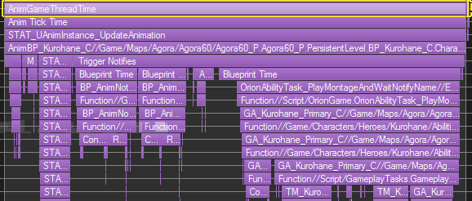
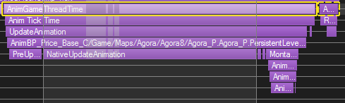
Animation Metrics (Tick)
Before and after optimization and anim instance nativization
Second capture is much simpler, ~23x faster
First step (Update) moved off to worker thread – still doing the work, but freeing up game thread
Notes:
Huge gain from nativization, but we still skip a bunch of work due to multithreading changes (the big STA… pile and bars before are the update step that we moved)

Slide 10

Significance
Distance/screen size LODS not great when everything happens in one place (team fight)
Significance system maintains item list in importance order
Importance determined by game specific logic
This allows us to have “Buckets” for game objects
Allow per-LOD limit (e.g. only 4 heroes at LOD1)
Normal LOD is updated as usual, significance system can then modify.
Significance score accessible by game logic + systems.
Notes:
10 heroes & 30+ minions can easily be all in the same place – normal LODs aren’t going to help there.

Slide 11
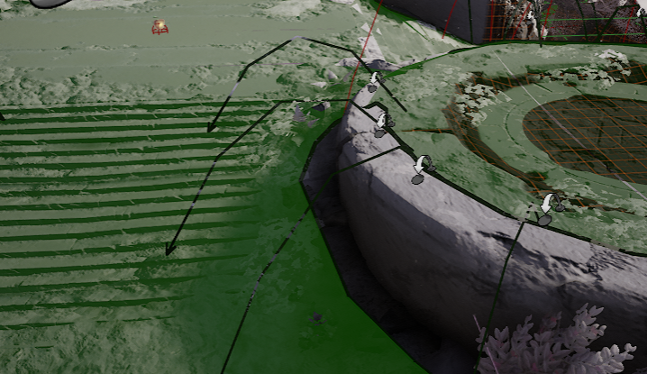
Character Movement
Aggressively reduce number of components on characters
Less transforms to update
AI use nav mesh on servers for collision
AI use lower tick rates on servers (net freq)
Rotation smoothing on client to interp
Improved interpolation to handle low frequency updates under variable lag
Use a network LOD solution tied to the significance system to lower visual update rates when not significant.
Can disable client collision resolution for certain LODs
Notes:
Nav mesh pretty low resolution, cheaper height and collision checks on server.
Lowering the update rate by network LOD pushes fewer transforms , much cheaper to just interp.
Disabled collisions separated between heroes / minions (want to keep doing heroes if possible)

Slide 12
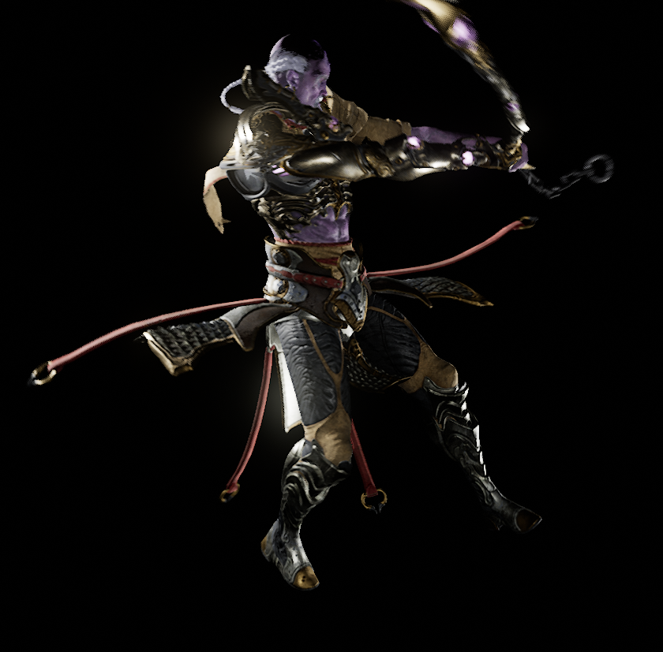
Character Physics 1/2
We wanted rich and dynamic characters, lots of “flappy bits” and physically active pieces
PhysX too heavy, lots of bodies – very complicated scenes
Wrote our own small rigid body solver “AnimDynamics”
No collision support
No scene management (broadphase, PCM)
No game thread work
No interaction with other physics objects

Slide 13
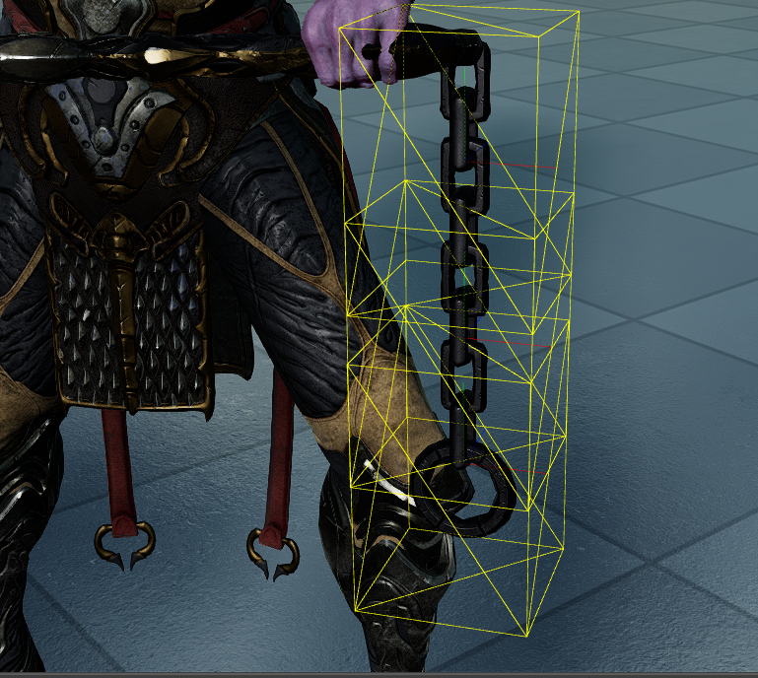
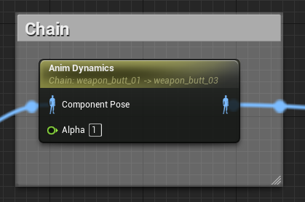
Character Physics 2/2
Single body & chain character attachments
Component space sim
Allows configurable constraints
Basic prismatic and angular constraint
Planar constraint
Supports linear and angular springs
Used as an animation blueprint node
Notes:
Forward Euler integration for position/velocity updates, RK4 approx. for orientation (maintains unstable spin better).
Has adaptive substepping for super complicated scenes.
Simulation is very configurable, down to number of iterations pre/post update per-constraint

Slide 14
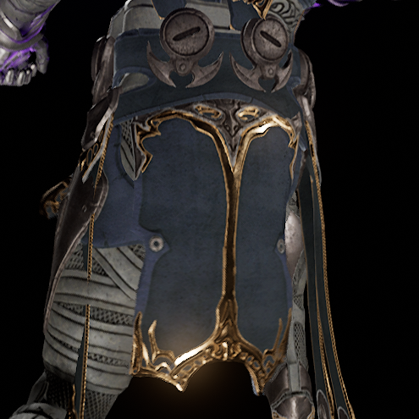
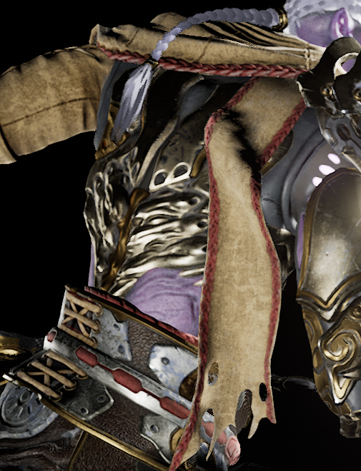
Clothing
Using Nvidia’s APEX as clothing solution
Worked closely with Nvidia to improve performance
Change to per-cloth simulation instead of per-scene
Allowed us to easily define per-character budgets for clothing
Removed redundant processing within APEX
Preparation work for cloth moved onto worker threads
~10-15x faster than 4.10
Notes:
Redundant processing -> CPU skinning (twice) and render data preparation. We never use the render functionality in APEX so it was completely uneccesary.
Due to all the changes and speed ups in cloth, the tick groups are simpler and there’s less waiting on cloth.

Slide 15
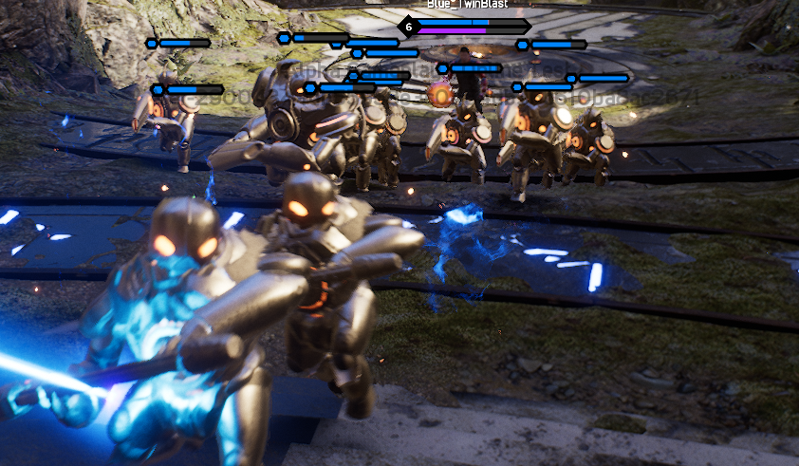
Scene Graph
Improved overlaps to avoid extra scene queries where possible
Improved Rotator <-> Quaternion conversions
Optimized actual conversion (SIMD + approximations)
Reduce the number of conversions taking place
Modified components to reduce virtual calls when moving
Reduced allocations and replaced allocator for remaining allocations with stack allocator
Rot/Quat Conv. (50 chars) | Before | After
R -> Q | 362 | 5
Q -> R | 206 | 0
Notes:
Added vectorized Equals and IsNearlyZero, ~2-3x faster
Table -> Before/After changes with 50 visible characters walking

Slide 16
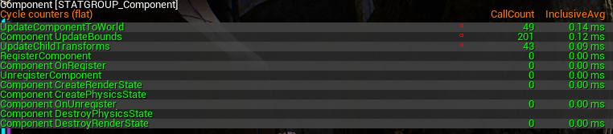
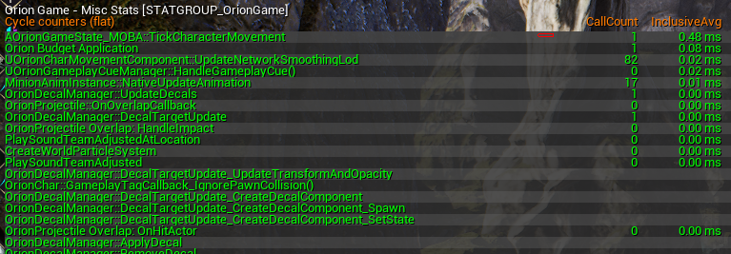
Actor Ticking
Constantly kept eyes on the number of objects ticking in game.
Reduce tick rate of certain objects, or use timer manager.
Tick some objects manually
Reduces task graph overhead and can improve cache coherence
Remove tick task dependencies where possible to reduce load on the task graph
Notes:
Manual Ticks -> Pulled all character movement ticks together, removed from task graph (saved us 0.3ms on PS4)

Slide 17
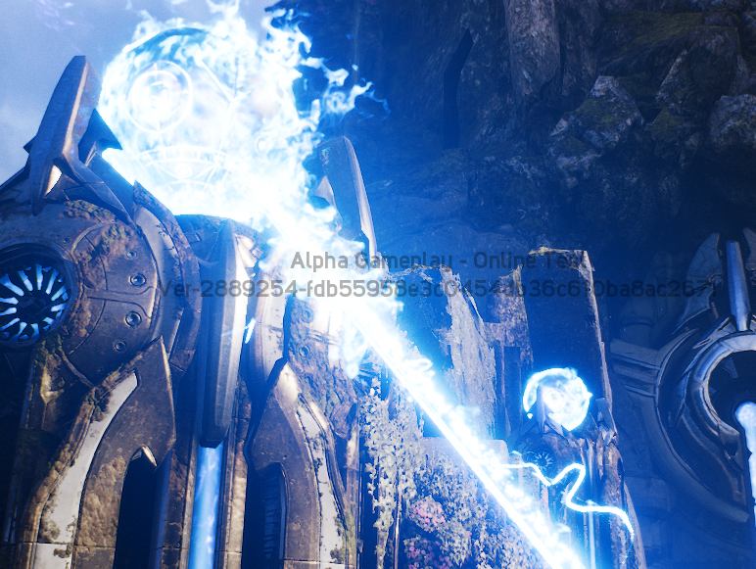
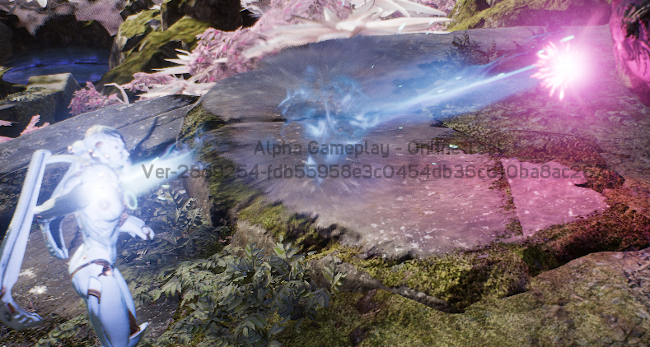
Particles
Improved particle initialization, pre-compute as much as possible
Added auto attach and detach particle systems when activating/deactivating.
Cuts down on transform updates
Spawn effects on-demand from game code (not attached)
Triggered by client, no server management
Combine with automatic attach/detach

Slide 18
Parallelizing the Renderer
Core target: 4-8+
Uses generic task graph
Data parallel passes broken up for load balancing e.g. EarlyZ / BasePass / Shadows / InitViews / Translucency
Platform independent command lists
Parallel command list generation (Currently DX11, PS4, XB1, DX12, later Vulkan)
Parallel command list translation where possible (PS4, XB1, DX12, later Vulkan)
Submission is ordered
D
T
S
D
D
T
D, D, D
T, T, T
S
D
T, T, T
S
D
T
S
D
D
T
Notes:
Platform independent command lists can be disable with “r.RHICmdBypass 0”.
Parallel command list generation could be done on all RHI.
ToggleRHIThread to do transl. on RT

Slide 19
CPU Summary
Vast improvements across the board throughout the engine:
Animation
Significance
Movement
Char. Physics
Clothing
Scene Graph
Actor Tick
Particles
Renderer
…
Notes:
Animation – Better multithreading, free up game thread, optimized update rates
Significance – New engine system to make quality decisions based on importance
Movement – Improved tick speed, reduced network ticks, more interpolation
Char. Physics – New anim physics solver, super fast and easy to set up
Clothing – Reduce redundancies, lower level integration, ~10-15x faster
Scene Graph – Faster overlaps, fewer quat conversions, faster allocation
Actor Tick – Constant monitoring, used manual ticking, reduced dependency
Particles – Improved init, auto attach/detach, on demand spawning
Parallizing the Renderer

Slide 20
G P U
Notes:
Topics are roughtly ordered by the render order in the frame

Slide 21
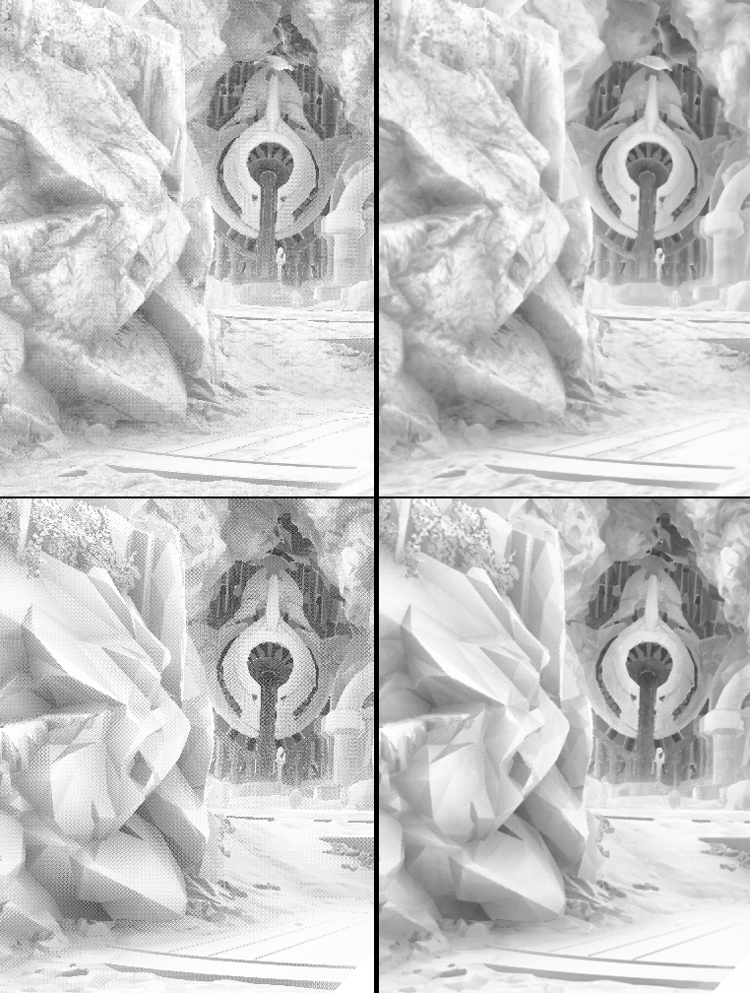
Screen Space
Ambient Occlusion
Shares HZB mips
Spatial and temporal variation
Shared TemporalAA benefits
ComputeShader based on depth buffer only Reconstruct normal from depth buffer * Faceted look on low poly content
AsyncCompute overlaps with BasePass to use underutilized GPU units
PlayStation 4
Single pass 1600x900, no bilateral up-sampling
13 samples (3 samples, *2 steps, *2 mirror, +1 center)
PixelShader 0.50 ms ComputeShader 0.65 ms AsyncCompute 0.2 ms
PixelShader
without TemporalAA
PixelShader
with TemporalAA
* http://humus.name/index.php?page=3D&ID=84
ComputeShader
without TemporalAA
ComputeShader
with TemporalAA

Slide 22
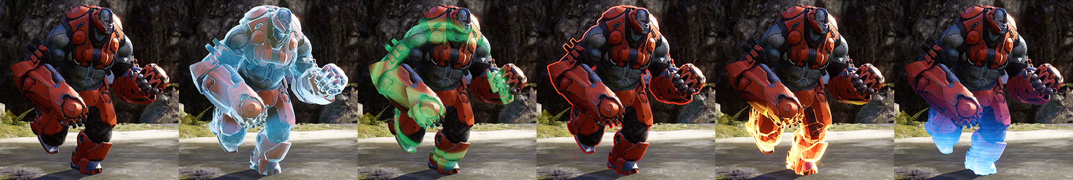
Deferred Decals
Moved CustomDepth earlier in the frame for DBuffer decals (r.CustomDepth.Order) DBuffer: Baked lighting with deferred decals CustomDepth: Application specific z buffer (also supports 256 Stencil values)
Paragon use:
CustomDepth/Stencil and Deferred Decals to visualize abilities on individual characters
Full screen pass to highlight characters behind walls
Environment decals
Effects, targeting
Notes:
to visualize abilities on individual characters:
Alternatives:
- re-rendering of the high poly character (costly)
- material (shader permutations, inefficient, not scalable to many abilities)

Slide 23
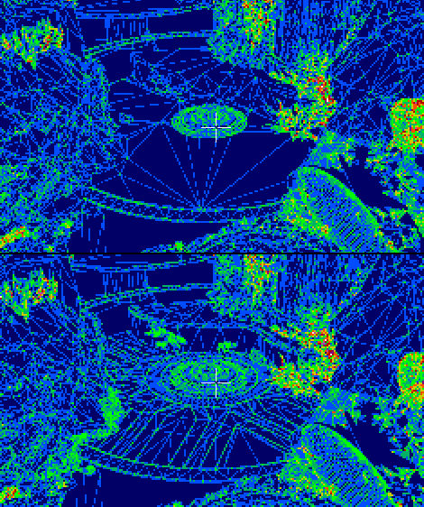
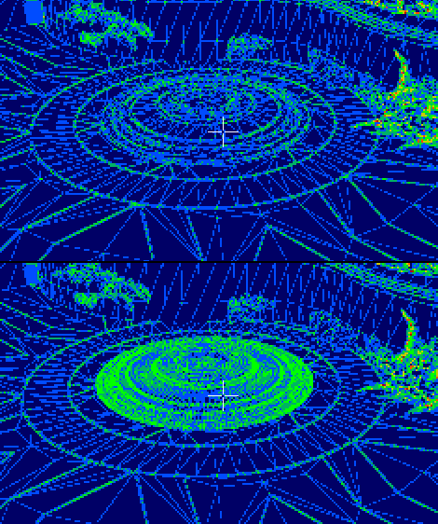

Level of Detail
Started aggressive to allow gameplay
To reduce:
Vertex count
Triangle count (Quad overdraw)
Draw calls (material merging)
Single full screen stencil dither transition
Skeletal meshes (5 LODs)
Very high poly to bake textures
Low poly from artist
Initial LODs: Simplygon
By hand & 3DSMax Pro Optimizer
HLOD (Simplygon)
Waited until 95% of meshing
Merge meshes, remove interior
Merge materials
Baked material attributes 1024 diffuse, 512 normal/metal/spec/roughness
Quad overdraw view mode
more about HLOD in GDC2016 “Hitting Budgets” talk
Notes:
Why vertex processing on AMD can be slow:
GCN Performance Tip 5: Limit Vertex and Domain Shader output size to 4 float4/int4 attributes for best performance. Notes: Outputs larger than 4 float4/int4 have increased parameter cache storage requirements which reduce wave occupancy (the number of wavefronts “in flight”) and may therefore impact performance. As an added bonus using fewer DS outputs will reduce PS interpolation cost.
On Skeletal mesh LOD:
Proto LOD's
initially created in engine using SimplyGon for quick testing/gameplay
Final LOD's
LOD0 - created by the original character artist who creates the high poly version
LOD1 - reduced by hand modelling in 3ds Max 100%
LOD2 - reduced by hand modelling in 3ds Max 80/90%, rigid objects can sometimes be reduced using Pro Optimizer modifier
LOD3 - reduced by using Pro Optimizer modifier primarily, hand modeling about 20% to ensure loops are in ideal areas for deformation
LOD4 - reduced by using Pro Optimizer modifier primarily, hand modeling about 10% to ensure loops are in ideal areas for deformation

Slide 24
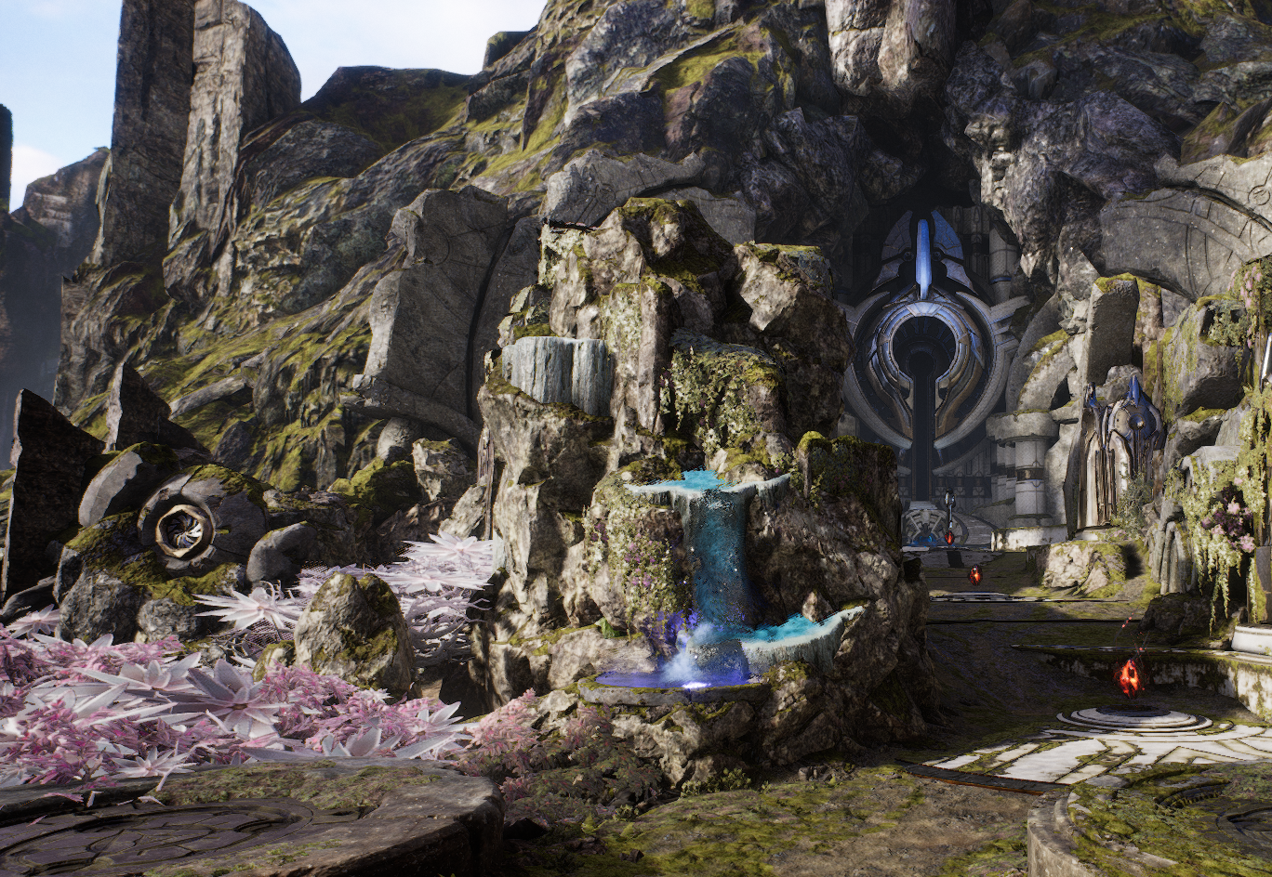
Example without HLOD
Triangle Count
No LODS 16.6 million
Regular LODs 2.3 million
down to 14%
HLODs 1.79 million
down to 11%
Draw Calls
No LODS 3940
HLODs 3400
down to 86%

Slide 25
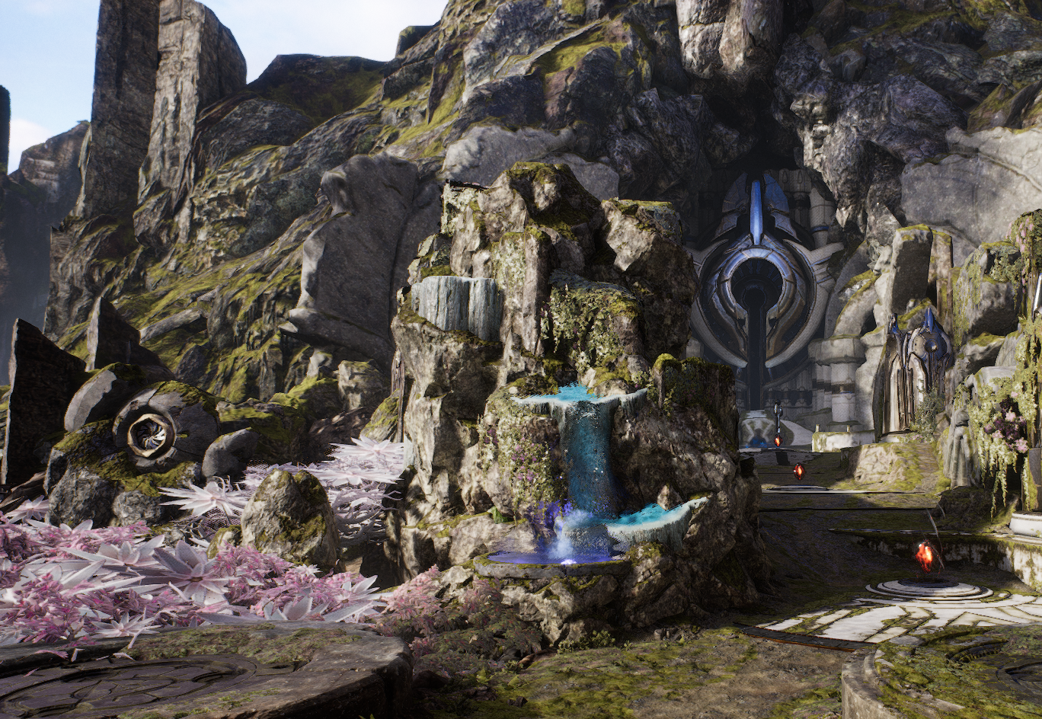
Example with HLOD
Triangle Count
No LODS 16.6 million
Regular LODs 2.3 million
down to 14%
HLODs 1.79 million
down to 11%
Draw Calls
No LODS 3940
HLODs 3400
down to 86%

Slide 26
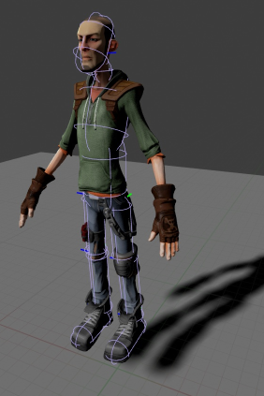
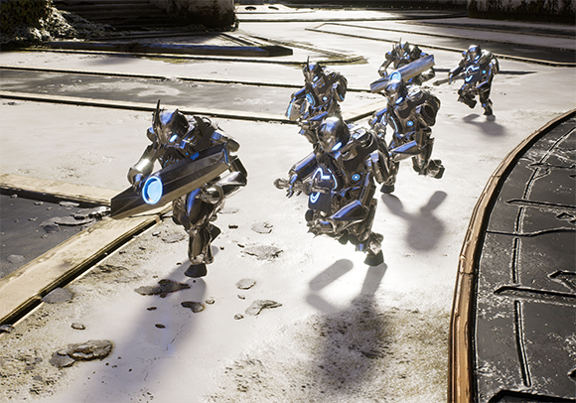
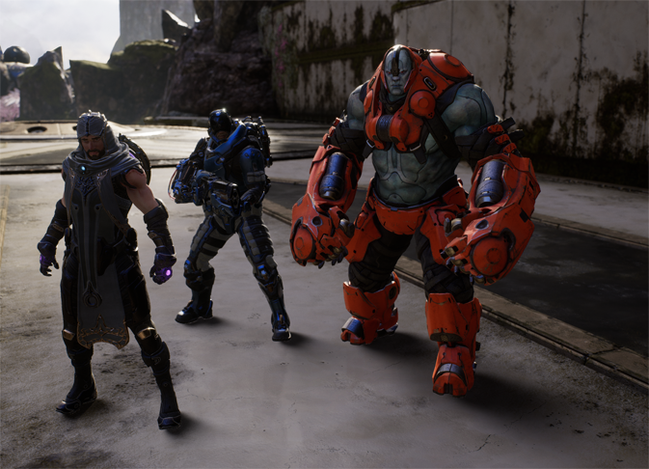
Shadowing
Setup
Direct shadowing
Static (Lightmass)
Baked distance field shadows
PreShadows
Cheap single sample PreShadows
Per object shadow maps
Capsule shadows for Skinned mesh
Setup similar to ragdolls
Contact hardening, based on analytical cone intersection
Direct shadowing
Direction from “receiver to light”
Softness from SourceRadius / SourceAngle
Extremely soft character shadows in baked lighting environment
Indirect shadowing
Direction and softness from Lightmass data
Computed in lower resolution
Indirect shadowing
Notes:
Indirect shadowing
Direction and softness from the Volume Lighting Samples placed and computed by Lightmass
Cheap single sample preshadows
Something similar in UE3 was called “Boolean Environment Shadowing”

Slide 27
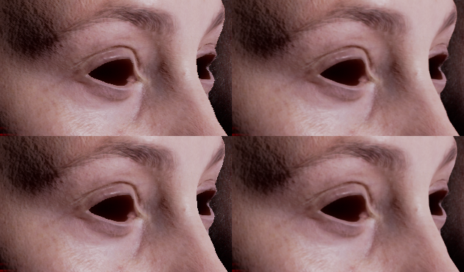

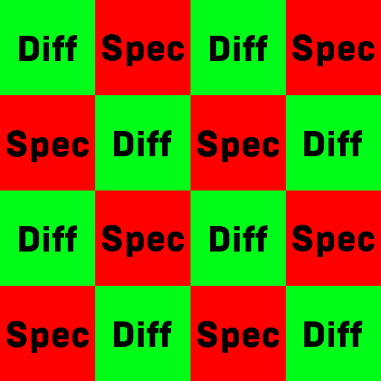
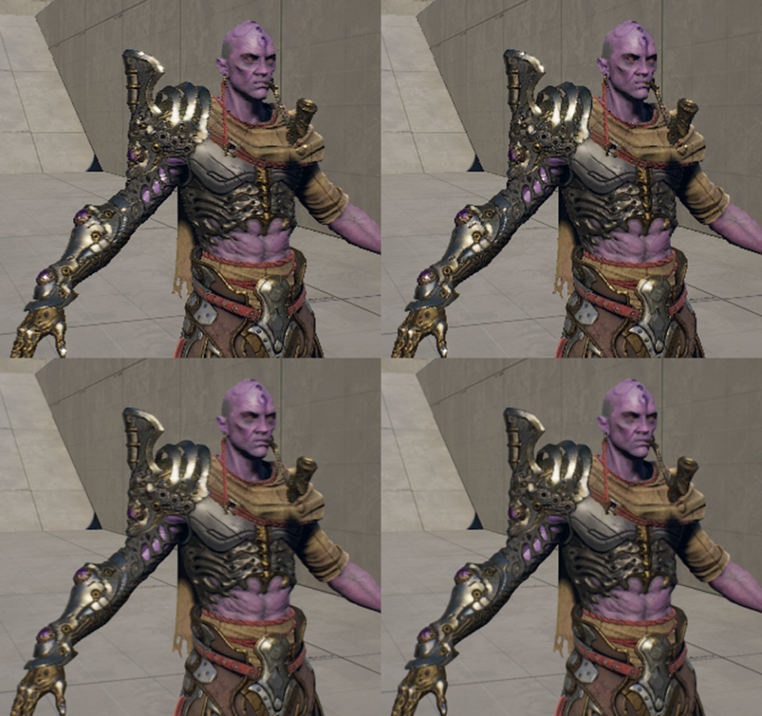
Screen Space Subsurface Scattering*
Digital Emily http://gl.ict.usc.edu/Research/DigitalEmily
Checker board instead of RGBA16f or 2xMRT
Passes
Base:
GBuffer unchanged
Checker board baked lighting
Lighting:
Checker board BaseColor & Specular
Few lines in HLSL, no C++
Scatter X&Y:
Half resolution for performance
Normalize RGB to account for energy loss
Recombine:
Undo checker board
Apply BaseColor & Specular
Apply BaseColor after scattering
Photo capture includes scattering
Crisper details
Checker board
Early in engine,
single bright point to visualize the sample pattern
Photo reference
* Jorge Jimenez http://www.iryoku.com
Notes:
Slightly less sharp and less correct Fresnel
For Poster videos (later), not for game play

Slide 28
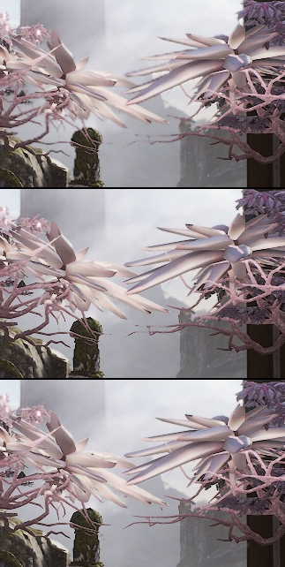
bad
Separate Translucency
… is an UE4 feature for translucency without Depth Of Field stored in a 64bit Render Target with pre multiplied alpha
Sample 0 of 2x2 full res depth
Now can render in lower resolution (half x and y)
Experimented with MSAA but settled on Nearest-Depth Neighbor up-sampling
Auto Downsample
Measure GPU time
Activate if below some threshold
Deactivate if above some threshold
Limit changes over times
better
Nearest-Depth Neighbor up-sampling
reference
See r.SeparateTranslucency…
Full resolution Translucency

Slide 29
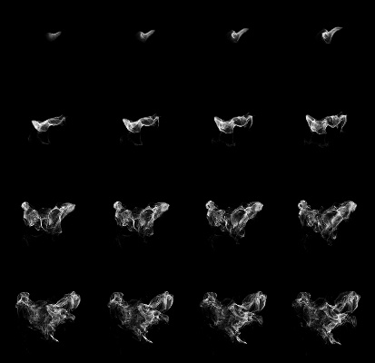
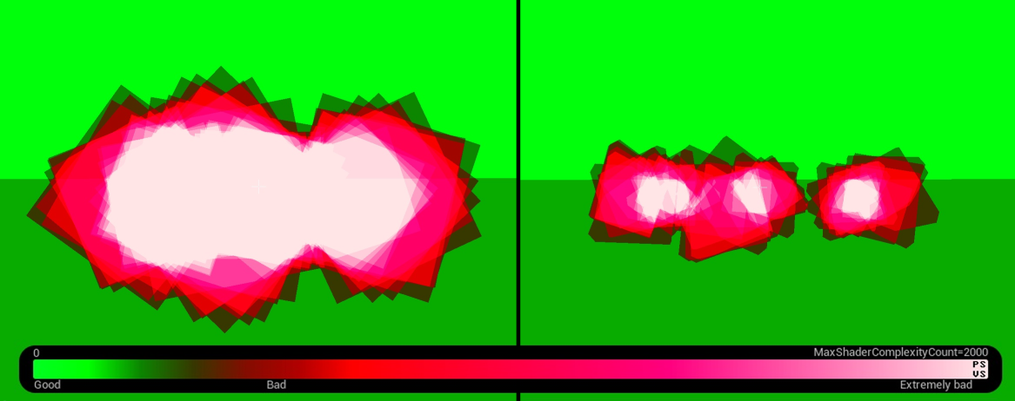
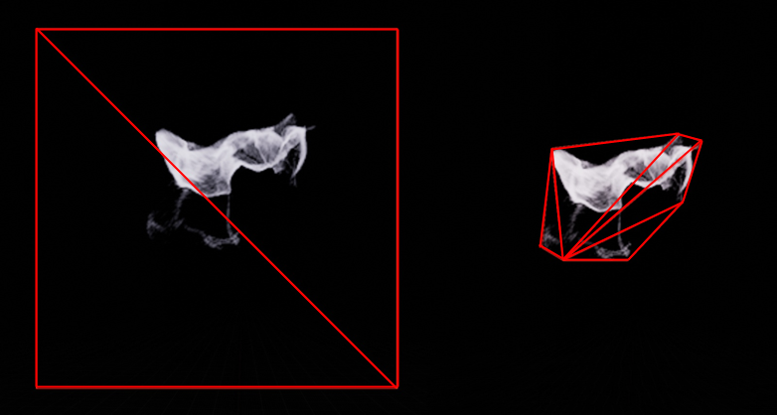
Particle Cutouts
Semi-automatic Engine feature
Depends on texture content and alpha threshold
Reduce Overdraw / PixelShader cost on translucent particles
Can be used on SubUVAnimation (1 x 1 for static texture)
More vertices/triangles
Doesn’t change texture content (no packing)

Slide 30
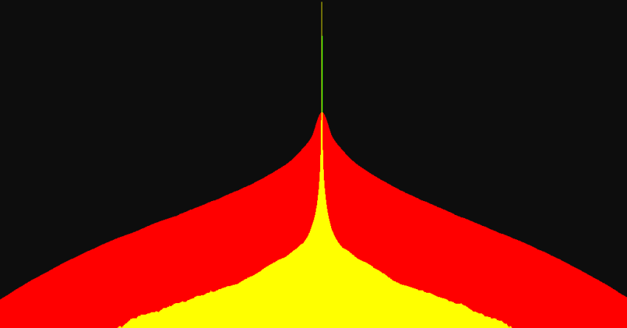
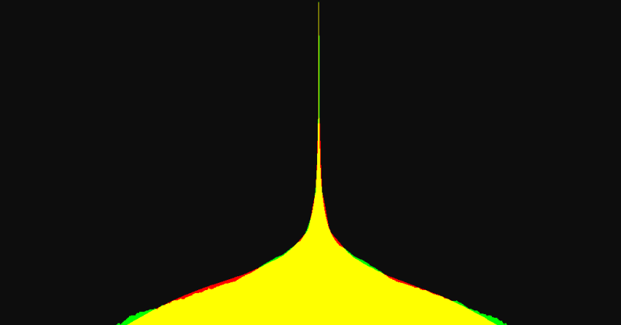

Bloom and Eye Adaptation
Default UE4
Since “Kite” we use more real Bloom settings (wide spike) matched to reference shot
No BloomThreshold (set to -1)
Non physical tweak
Not needed with new settings, faster, less passes
Might remove the feature completely
New EyeAdaptation method: “Basic”
Single value log from down sample
No Compute Shader requirement
Center weighted metering
bad
Kite / UT / Paragon
good
Bloom response of a bright center pixel
Green/Yellow: Reference from SLR
Red: In Engine
X is screen position
Y is brightness (non linear scaled)
EyeAdaptation weighting function

Slide 31
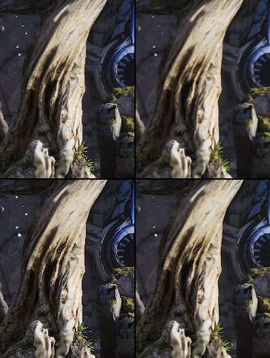

Uber Tone mapper
Tone mapper: from ALU + 16x16x16 LDR LUT to 32x32x32 HDR LUT in 10:10:10 format
Sharpen: from LDR PostProcessMaterial to HDR 4 extra samples in tone mapper avoid halos by masking bright content
Upscale: from 6 samples LDR to HDR: Bright content appears to grow
r.TonemapperFilm 1
r.Tonemapper.Sharpen 0.6
r.Tonemapper.ScreenPercentage 1
No PostProcessMaterial after tone mapping
without Sharpen
without TemporalAA
without Sharpen
with TemporalAA
bad
better
Sharpen / Blur
with Sharpen
without TemporalAA
with Sharpen
with TemporalAA
very bad
good
Notes:
from 6 samples LDR: directional blur with unsharp masked, lower spec option is 4 bilinear samples

Slide 32

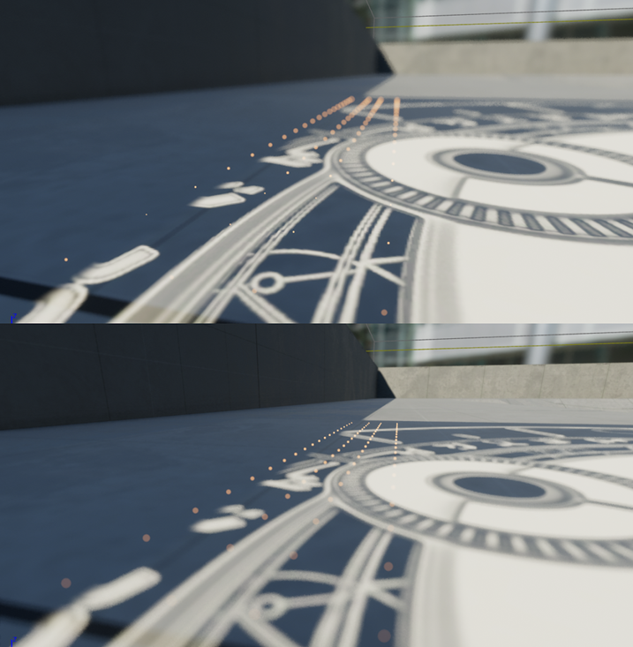
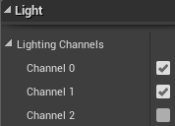

Posters
Character teaser video
Rendered in UE4 in 4K
High quality settings
Subsurface Scattering, Hair, Eyes
Strong Depth of Field
Lighting Channels
Circle Depth of Field
Like in “Kite” but more samples
Material expression “DepthOfFieldFunction”
Small Particles use material function “ParticleDOF”

Slide 33
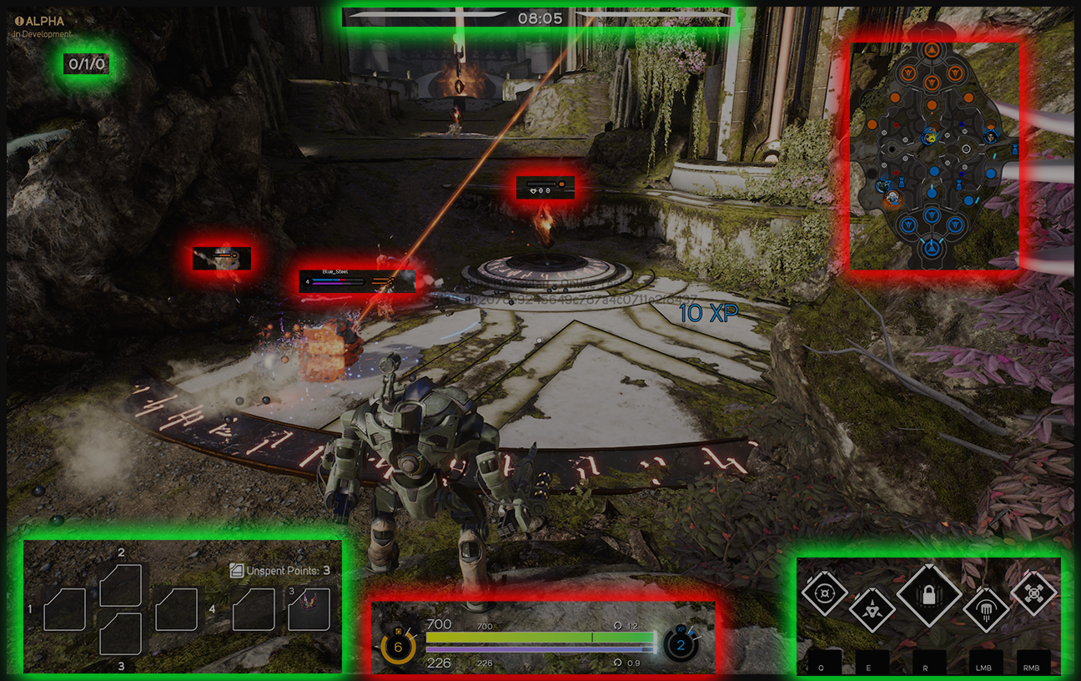
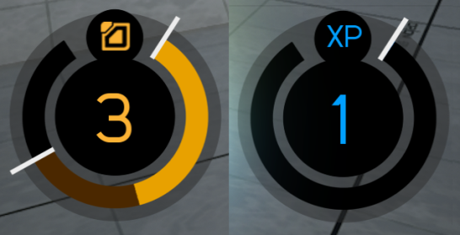
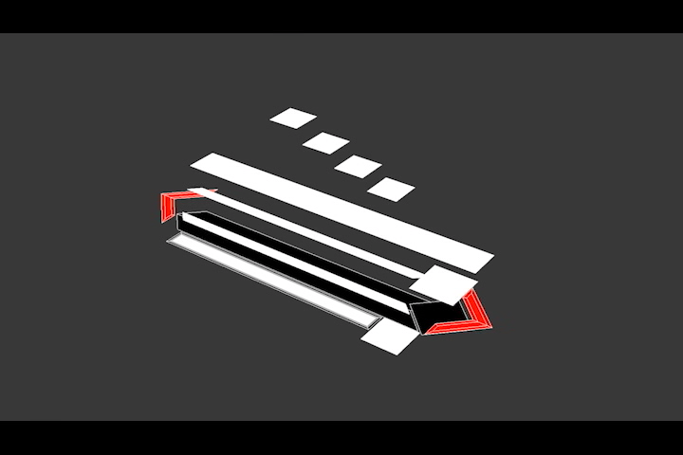
User Interface
Experimented with 3D UI
60 Hz, some elements lower frequency
Resolution independent scaling
Unreal Motion Graphics (UMG)
SMeshWidget
3D mesh authored in 3DSMax
Hardware instancing
2D distance functions in material analytical AA using ddx/ddy and 2
Other UMG widgets
Authored in UE4 editor

Slide 34
There is sooo much more …
Reversed index buffer instead of changing cull winding to avoid context rolls from mirrored geometry
HSync support on PS4. Allows tearing on top x% of screen to help cover frame spikes.
Improved MotionBlur, Velocity from APEX Cloth
Selective MRT output in BasePass
Per-vertex translucency lighting
Improved Streaming system
Memory management
Load times
…
We are not done ..

Slide 35

We’re Hiring
epicgames.com/careers
THANK YOU!

Slide 36
Q & A

Slide 37
Bonus 1/2
r.ProfileGPUSort 2, ProfileGPU Dumps an entry for every material draw event, sorted by rendered triangles. Top of this list hints wasted triangles. Use good asset names
ToggleDrawEvents this enables high level markers during the frame like 'BasePass' and 'PostProcessing'
ShowMaterialDrawEvents this shows a marker around each draw call with the material used
ToggleRHIThread some events are lost when parallel rendering is enabled
r.PS4ContinuousSubmits 0 this submits all commands in the frame as a single submission to the GPU to get pure GPU timings without bubbles caused by starvation
r.PS4StallsOnMarkers 1
ListTextures

Slide 38
Bonus 1/2
Name | Help
r.ParallelBasePass | Toggles parallel base pass rendering. Parallel rendering must be enabled for this to have an effect.
r.ParallelInitViews | Toggles parallel init views. 0 = off; 1 = on
r.ParallelPrePass | Toggles parallel zprepass rendering. Parallel rendering must be enabled for this to have an effect.
r.ParallelShadows | Toggles parallel shadow rendering. Parallel rendering must be enabled for this to have an effect.
r.ParallelShadowsNonWholeScene | Toggles parallel shadow rendering for non whole-scene shadows. r.ParallelShadows must be enabled for this to have an effect.
r.ParallelTranslucency | Toggles parallel translucency rendering. Parallel rendering must be enabled for this to have an effect.
r.ParallelVelocity | Toggles parallel velocity rendering. Parallel rendering must be enabled for this to have an effect.
r.RHICmdUseParallelAlgorithms | True to use parallel algorithms. Ignored if r.RHICmdBypass is 1.
r.RHICmdBypass | Whether to bypass the rhi command list and send the rhi commands immediately. 0: Disable (required for the multithreaded renderer) 1: Enable (convenient for debugging low level graphics API calls, can supress artifacts from multithreaded renderer code)

